Slide 1
Register Allocation
Ding Yaoyao
yyding@sjtu.edu.cn

Slide 2
Register Allocation
Why?
Why important?
How?

Slide 3
Naive Register Allocation
All virtual registers store in memory
Fetch into physical register when needed and store back after operation

Slide 4
Graph Register Allocation
Liveness Analysis
Approximate algorithm

Slide 5
Liveness Analysis
A variable v is live at point p if and only if there exists a path in the CFG from p to a use of v along which v is not redefined.
UEVar(m) contains the upward-exposed variables in m (those variables that are used in m before any redefinition in m)
VarKill(m) contains all the variables that are defined in m
For each block b, define LiveOut(b) as all the variables that are live on exit from b

Slide 6
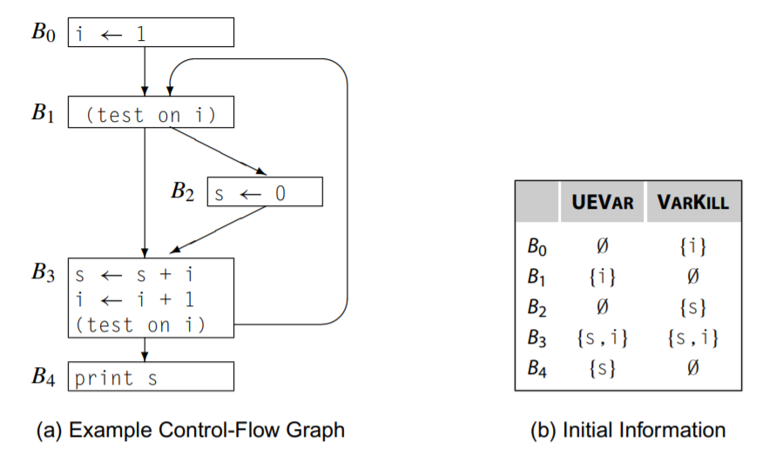
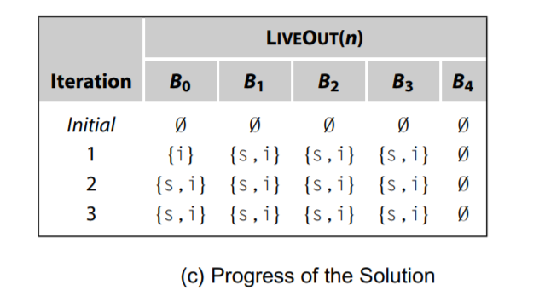
Example

Slide 7
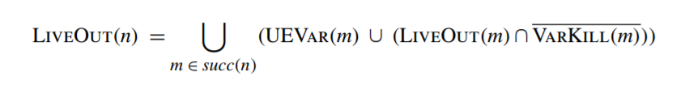
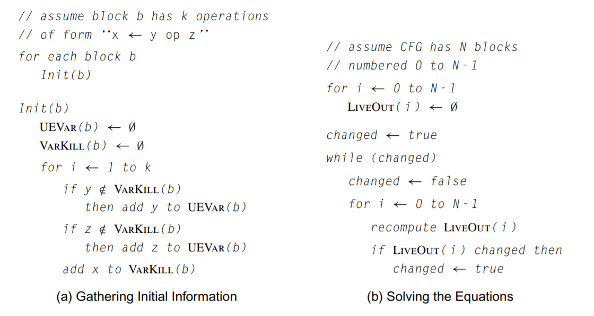
Algorithm

Slide 8
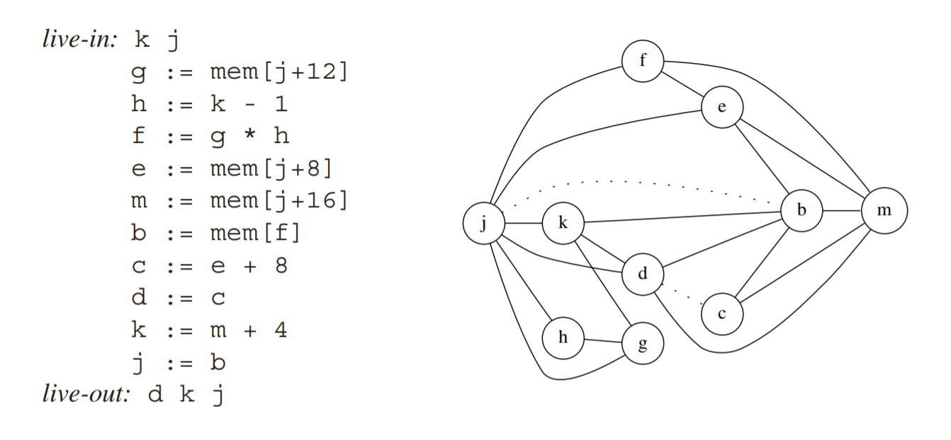
Interference Graph

Slide 9
Simple Graph Register Allocation
Build – construct interference graph
Simplify – reduce to a smaller problem
Spill – (potential spill)
Select – assign colors (physical register)

Slide 10
Simple Graph Register Allocation
While True:
Build Interference Graph
Simplifylist = Nodes Whose Degree < K
Spilllist = Nodes Whose Degree >= K
While Simplifylist Or Spilllist Not Empty:
If Simplifylist Not Empty: Simplify()
Else: Potentialspill()
Assigncolor()
If Success: Break
Else: Realspill()

Slide 11
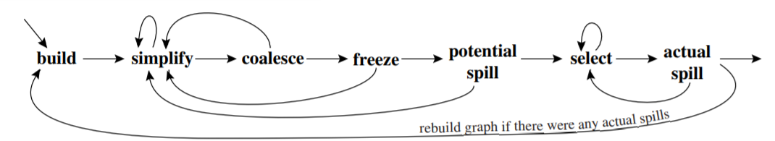
More Advanced Graph Register Allocation
A piece of cake for you.

Slide 12
Reference
Liveness Analysis: Engineering A Compiler
Graph Register Allocation: Tiger Book
Zhihu: https://www.zhihu.com/question/29355187

